Slide 1
Smart-Farm
1208-박진홍

Slide 2
파일 구조
image
*.png
*.jpg
Project
Ui.py
Ui_run.py
server
static
style.css
templates
main.html
app.py
background
Background.qrc
Background.py
DB_data
main.db

Slide 3
클라이언트
아두이노

Slide 4
아두이노
서버
client
client
client
client
client
client
client
client

Slide 5
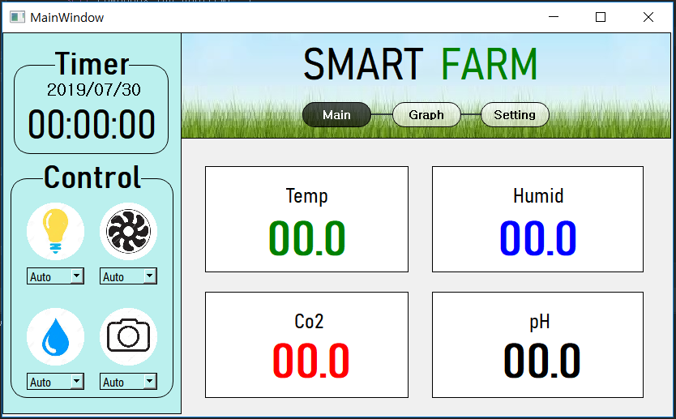
메인 화면 디자인

Slide 6
StackedWidget를 이용한 화면 넘기기
from my import*
import PyQt5
from functools import partial
import time
import threading
import datetime
import requests
class EventThread(PyQt5.QtCore.QThread):
def __init__(self, ui):
self.mainButton_list = [ui.btn_main_off, ui.btn_graph_off, ui.btn_setting]
for i, mainButton in enumerate(self.mainButton_list):
mainButton.clicked.connect(partial(ui.stackedWidget.setCurrentIndex, i))

Slide 7
comboBox 값 변환 확인
class comboBoxChange:
def fan(self):
data = ui.comboBox_fan.currentText()
if data == 'Manual':
print('선풍기 수동 모드')
else:
print('선풍기 자동 모드')
def led(self):
data = ui.comboBox_led.currentText()
if data == 'Manual':
print('LED 밝기 수동 모드')
else:
print('LED 밝기 자동 모드')
def water(self):
data = ui.comboBox_water.currentText()
if data == 'Manual':
print('물 주기 수동 모드')
else:
print('물 주기 자동 모드')
def picture(self):
data = ui.comboBox_picture.currentText()
if data == 'Manual':
print('사진 촬영 수동 모드')
else:
print('사진 촬영 자동 모드')
def signals(ui):
ui.comboBox_fan.currentIndexChanged.connect(comboBoxChange.fan)
ui.comboBox_water.currentIndexChanged.connect(comboBoxChange.water)
ui.comboBox_led.currentIndexChanged.connect(comboBoxChange.led)
ui.comboBox_picture.currentIndexChanged.connect(comboBoxChange.picture)

Slide 8
Threading을 이용한 시간 변화
class date_time:
def change_time(ui):
while True:
date = datetime.datetime.now()
date = date.strftime('%H:%M:%S')
ui.label_time.setText(date)
time.sleep(1)
def change_date(ui):
while True:
date1 = datetime.datetime.now()
date1 = date1.strftime('%Y-%m-%d')
ui.label_29.setText(date1)
time.sleep(1)

Slide 9
Sensor 값 받기 - 아두이노
void loop()
{
float temp, humi;
unsigned char err;
if((err=dht11.read(humi,temp))==0){
Serial.print("t:");
Serial.print(temp);
Serial.print("h:");
Serial.print(humi);
Serial.println();
}
delay(3000);
}
#include <DHT11.h>
int temp = 2;
DHT11 dht11(temp);
void setup() {
Serial.begin(9600);
}

Slide 10
Sensor 값 받기 - 서버
from flask import Flask, render_template
import serial
import threading
ser = serial.Serial(
port='COM11',
baudrate=9600,
parity=serial.PARITY_NONE,
stopbits=serial.STOPBITS_ONE,
bytesize=serial.EIGHTBITS,
timeout=1)
app = Flask(__name__)
def receive_data():
while True:
rxdata = ser.readline().decode('utf-8')
if rxdata:
print(rxdata)
return rxdata
@app.route('/')
def index():
data = receive_data()
return data
@app.route('/main')
def main():
data = receive_data()
temp = data[2:7]
humid = data[9:14]
return render_template('main.html', temp=temp, humid=humid)
if __name__ == '__main__':
app.run(host='10.156.147.138', port=5000)

Slide 11
Sensor 값 받기 – 클라이언트(통신)
class sensor:
def sensor_date(ui):
url = 'http://10.156.147.138:5000/'
while True:
res = requests.get(url=url)
data = res.text
temp = data[2:7]
humid = data[9:14]
ui.label_temp.setText(temp)
ui.label_humid.setText(humid)
dt = datetime.datetime.now()
time_text = dt.strftime("%H:%M:%S")
date_text = dt.strftime("%Y-%m-%d")

Slide 12
Sensor 값 받기 – 클라이언트(DB)
con = sqlite3.connect('./db_data/main.db')
cur = con.cursor()
cur.execute("CREATE TABLE if not exists SensorData(Date text, Time text, Temp text, Humid text);")
cur.execute(f'INSERT INTO SensorData VALUES("{date_text}", "{time_text}", "{temp}", "{humid}");')
con.commit()
cur.execute("SELECT * FROM SensorData;")
con.close()
time.sleep(3)

Slide 13
메인 함수 실행 및 Thread 구현
if __name__ == '__main__':
import sys
app = QtWidgets.QApplication(sys.argv)
MainWindow = QtWidgets.QMainWindow()
ui = Ui_MainWindow()
ui.setupUi(MainWindow)
MainWindow.show()
signals(ui)
eventThread = EventThread(ui)
thread1 = threading.Thread(target=date_time.change_time, args=(ui,))
thread1.daemon = True
thread1.start()
thread2 = threading.Thread(target=date_time.change_date, args=(ui,))
thread2.daemon = True
thread2.start()
thread3= threading.Thread(target=sensor.sensor_date, args=(ui,))
thread3.daemon = True
thread3.start()
sys.exit(app.exec_())

Slide 14
render_template에 필요한 html 코드
<!DOCTYPE html>
<html lang="en">
<head>
<meta charset="UTF-8">
<title>Smart Farm</title>
<link type="text/css" rel="stylesheet" href="/static/style.css" />
</head>
<body>
<div>
<div id="temp">Temp</div>
<div style="width: 200px; float:left;">.</div>
<div id="humi">Humi</div>
</div>
<div>
<div id="temp_text">{{temp}}</div>
<div style="width: 290px; float:left;">.</div>
<div id="humi_text">{{humid}}</div>
</div>
</body>
</html>

Slide 15
디자인을 위한 css 코드
#temp_text {
margin-left: 490px;
float: left;
max-width: 100%;
font-size: 70px;
color: red;
margin-left: 520px;
}
#humi_text {
max-width: 100%;
font-size: 70px;
margin-top: 200px;
color: blue;
margin-top: 60px;
}
#temp {
margin-left: 490px;
float: left;
max-width: 100%;
font-size: 100px;
}
#humi {
max-width: 100%;
font-size: 100px;
margin-top: 200px;
}

Slide 16
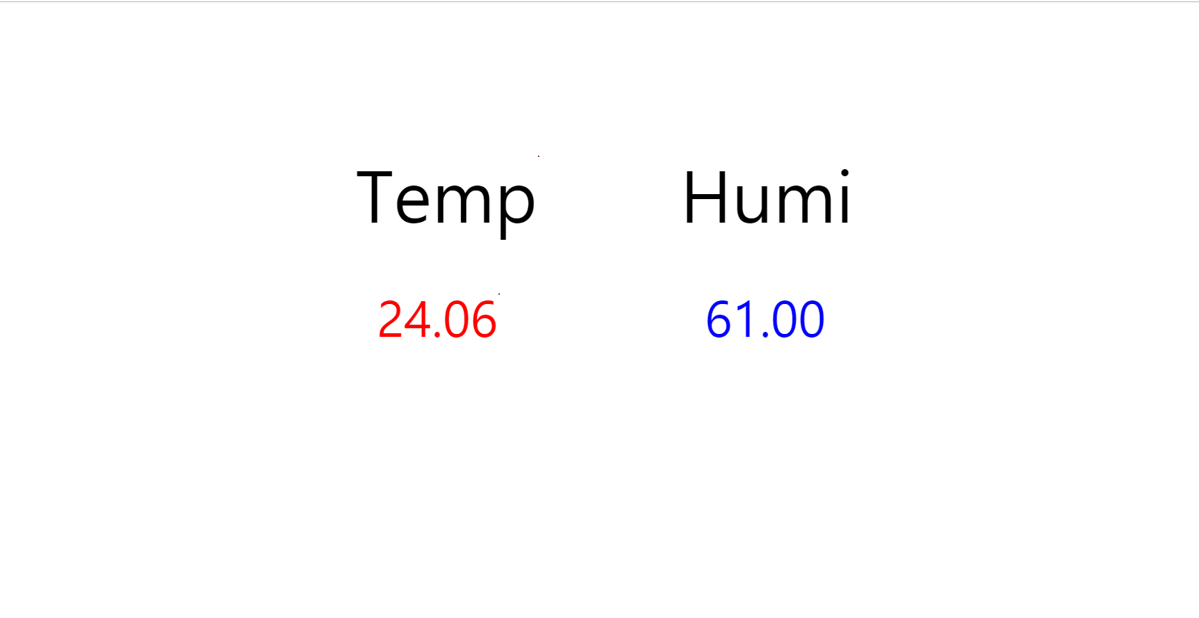
Web page view

